Slide 1
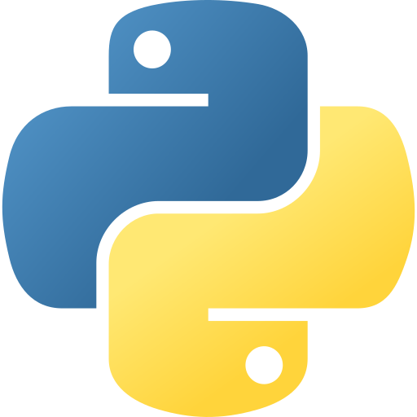
Python
Learning Python as a beginner can be an exciting journey.

Slide 2
Agenda
Introduction to python
Installing Python
Writing Your First Program
Variable and Data Types
Comments and Docstring
Basic Operation
Control Flow – Conditional Statement
Loop
Functions
List and Data Structure
Dictionaries
Libraries and Modules

Slide 3
Introduction to Python
Python is a high-level, interpreted programming language.
It's known for its simplicity and readability.
Python is versatile and widely used in web development, data analysis, machine learning, and more.

Slide 4
Installing Python
You can download Python from the official website (https://www.python.org/).
Choose the appropriate version for your operating system.

Slide 5
Writing Your First Python Program
Open a text editor (e.g., VSCode, Notepad++) to write Python code.
Start with the traditional "Hello, World!" example:

Slide 6
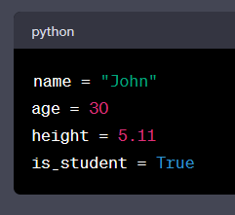
Variables and Data Types
Variables are used to store data.
Common data types include integers, floats, strings, and booleans.

Slide 7
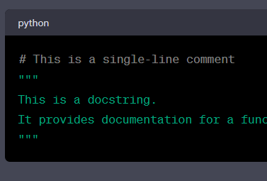
Comments and Docstrings
Comments are used for code documentation and are not executed.
Docstrings provide multi-line documentation for functions and classes.

Slide 8
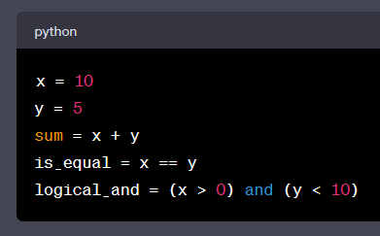
Basic Operators
Python supports arithmetic, comparison, and logical operators.

Slide 9
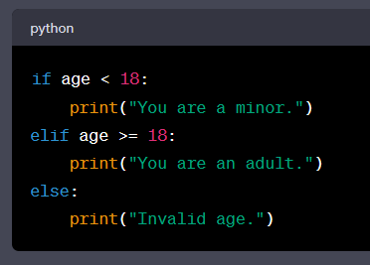
Control Flow - Conditional Statements
Use `if`, `elif`, `else` to control program flow

Slide 10
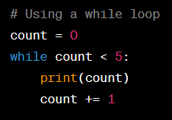
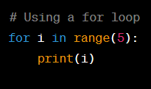
Loops
Use for and wile loop for repetitive tasks,

Slide 11
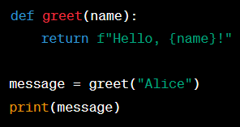
Functions
Functions are reusable blocks of code.
They can take parameters and return values.

Slide 12

Lists and Data Structures
Lists are used to store collections of data.

Slide 13
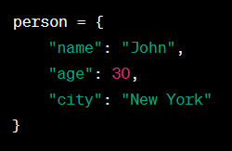
Dictionaries
Dictionaries

Slide 14
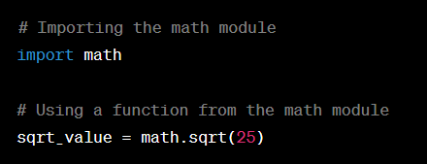
Libraries and Modules
Python has a vast standard library and external modules for various tasks.

